Slide 1
Chad - IntelliJ4Life
Colton, Sandeep, Scott
Not Pictured: Ryan, Chris

Slide 2
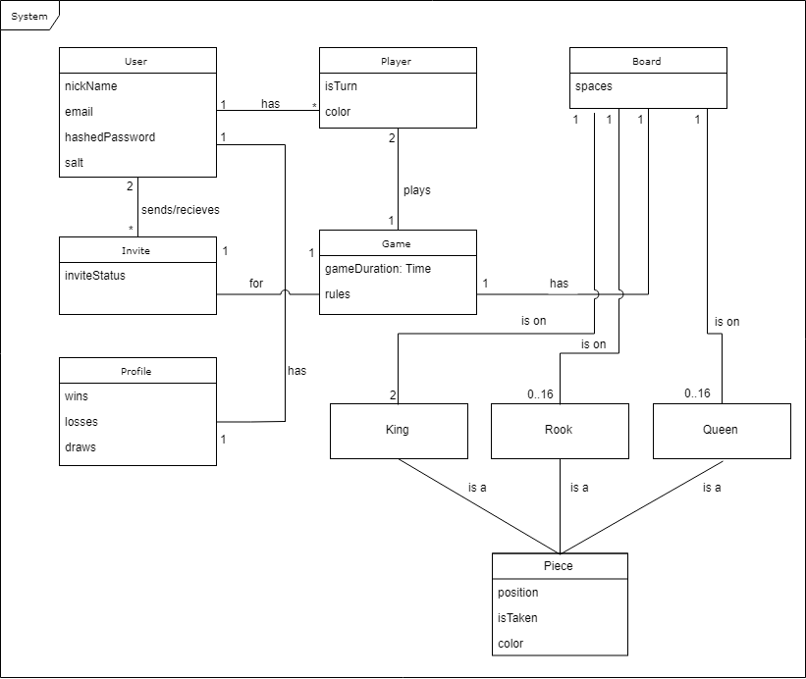

Slide 3
User
nickName - User's unique nickname
email - User's email
hashedPassword - Hash generated from hashing password + salt
salt - Random number used to secure password

Slide 4
Player
isTurn - Is it the player's turn?

Slide 5
Board
spaces - a 2d array which a Piece can occupy

Slide 6
Invite
inviteStatus - Can be [open, accepted, rejected]

Slide 7
Game
gameDuration: Time - Elaped time of game from start of game
rules - Text player can read to understand how game is played

Slide 8
Profile
wins - Count of a profile's game wins
losses - Count of a profile's game losses
draws - Count of a profile's game draws

Slide 9
Piece
position - Where the piece is on the board
isTaken - If the piece is on the board or not
color - What color the piece belongs to

Slide 10
P1 improvements to deliverables
Fixed the following:
Any typos in our use cases
Any subflows that should have been part of the main flow for use cases
Diagram labels match each of the use cases
Diagram actors match use case actors

